Slide 1
MapReduce
Simplified Data Processing on Large Clusters (Without the Agonizing Pain)
Presented by Aaron Nathan

Slide 2
The Problem
Massive amounts of data
>100TB (the internet)
Needs simple processing
Computers aren’t perfect
Slow
Unreliable
Misconfigured
Requires complex (i.e. bug prone) code

Slide 3
MapReduce to the Rescue!
Common Functional Programming Model
Map Step map (in_key, in_value) -> list(out_key, intermediate_value)
Split a problem into a lot of smaller subproblems
Reduce Step reduce (out_key, list(intermediate_value)) -> list(out_value)
Combine the outputs of the subproblems to give the original problem’s answer
Each “function ” is independent
Highly Parallelizable

Slide 4
Algorithm Picture
DATA
MAP
MAP
MAP
MAP
MAP
K1:v K1:v K2:v
K2:v
K1:v
K2:v K3:v
K3:v
aggregator
K1:v,v,v
K2:v,v,v
K3:v,v,v
REDUCE
REDUCE
REDUCE
Answer!
Answer!
Answer!

Slide 5
Some Example Code
map(String input_key, String input_value):
// input_key: document name
// input_value: document contents
for each word w in input_value:
EmitIntermediate(w, "1");
reduce(String output_key, Iterator intermediate_values):
// output_key: a word
// output_values: a list of counts int result = 0;
for each v in intermediate_values:
result += ParseInt(v);
Emit(AsString(result));

Slide 6
Some Example Applications
Distributed Grep
URL Access Frequency Counter
Reverse Web Link Graph
Term-Vector per Host
Distributed Sort
Inverted Index

Slide 7
The Implementation
Google Clusters
100s-1000s Dual Core x86 Commodity Machines
Commodity Networking (100mbps/1Gbps)
GFS
Google Job Scheduler
Library linked in c++

Slide 8
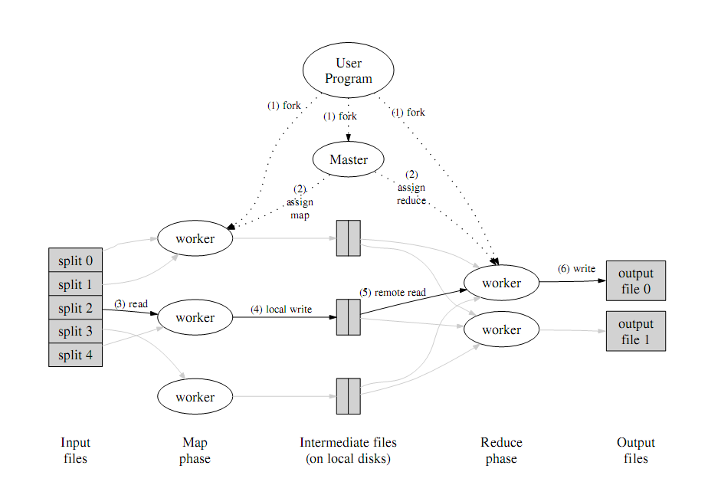
Execution

Slide 9
The Master
Maintains the state and identify of all workers
Manages intermediate values
Receives signals from Map workers upon completion
Broadcasts signals to Reduce workers as they work
Can retask completed Map workers to Reduce workers.

Slide 10
In Case of Failure
Periodic Pings from Master->Workers
On failure resets state of assigned task of dead worker
Simple system proves resilient
Works in case of a 80 simultaneous machine failures!
Master failure is unhandled.
Worker Failure doesn’t effect output (output identical whether failure occurs or not)
Each map writes to local disk only
If a mapper is lost, the data is just reprocessed
Non-deterministic map functions aren’t guaranteed

Slide 11
Preserving Bandwidth
Machines are in racks with small interconnects
Use location information from GFS
Attempts to put tasks for workers and input slices on the same rack
Usually results in LOCAL reads!

Slide 12
Backup Execution Tasks
What if one machine is slow?
Can delay the completion of the entire MR Operation!
Answer: Backup (Redundant) Executions
Whoever finishes first completes the task!
Enabled towards the end of processing

Slide 13
Partitioning
M = number of Map Tasks (the number of input splits)
R = number of Reduce Tasks (the number of intermediate key splits)
W = number of worker computers
In General:
M = sizeof(Input)/64 MB
R = W*n (where n is a small number)
Typical Scenario: InputSize = 12 TB, M = 200,000, R = 5000 W = 2000

Slide 14
Custom Partitioning
Default Partitioned on intermediate key
Hash(intermediate_key) mod R
What if user has apriori knowledge about the key?
Allow for user-defined hashing function
Ex. Hash(Hostname(url_key))

Slide 15
The Combiner
If reducer is associative and communivitive
(2 + 5) + 4 = 11 or 2 + (5 + 4) = 11
(15+x)+2=2+(15+x)
Repeated intermediate keys can be merged
Saves network bandwidth
Essentially like a local reduce task

Slide 16
I/O Abstractions
How to get initial key value pairs to map?
Define an input “format”
Make sure splits occur in reasonable places
Ex: Text
Each line is a key/pair
Can come from GFS, bigTable, or anywhere really!
Output works analogously

Slide 17
Skipping Bad Records
What if a user makes a mistake in map/reduce
And only apparent on few jobs..
Worker sends message to Master
Skip record on >1 worker failure and tell others to ignore this record

Slide 18
Removing Unnecessary Development Pain
Local MapReduce Implementation that runs on development machine
Master has HTTP page with status of entire operation
Shows “bad records”
Provide a Counter Facility
Master aggregates “counts” and displayed on Master HTTP page

Slide 19
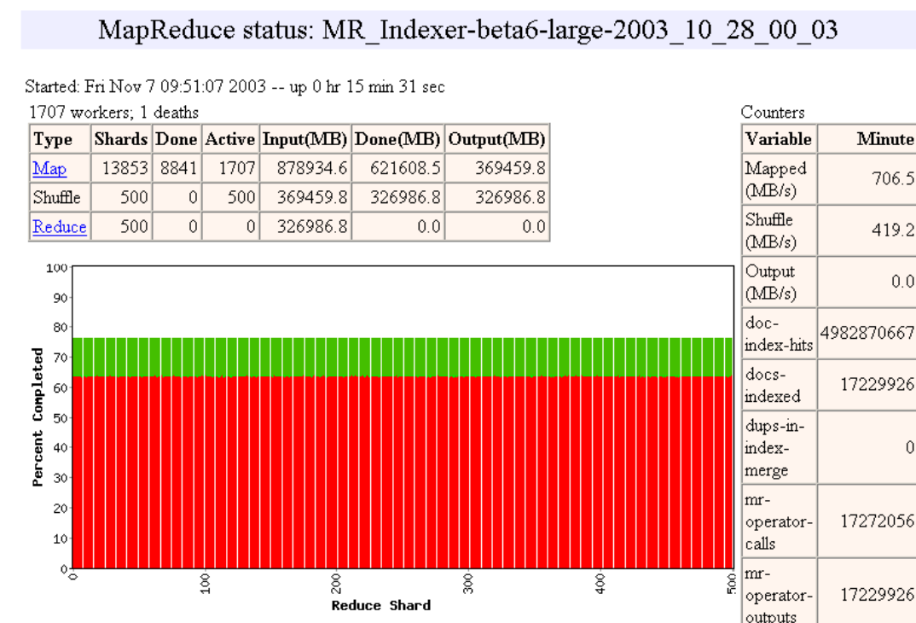
A look at the UI (in 1994)
http://labs.google.com/papers/mapreduce-osdi04-slides/index-auto-0013.html

Slide 20

Performance Benchmarks
Sorting AND Searching

Slide 21
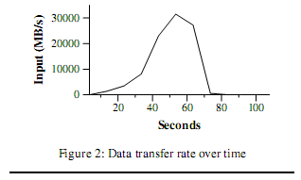
Search (Grep)
Scan through 10¹⁰ 100 byte records (1TB)
M = 15000, R = 1
Startup time
GFS Localization
Program Propagation
Peak -> 30 GB/sec!

Slide 22
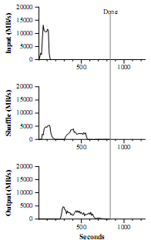
Sort
50 lines of code
Map->key + textline
Reduce-> Identity
M = 15000, R = 4000
Partition on init bytes of intermediate key
Sorts in 891 sec!

Slide 23
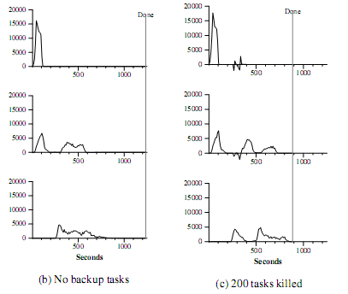
What about Backup Tasks?

Slide 24
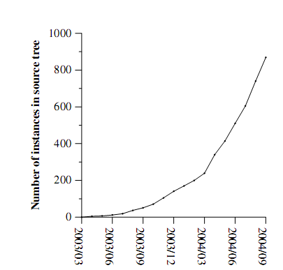
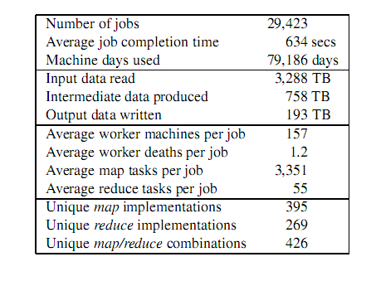
And wait…it’s useful!
NB: August 2004

Slide 25

Open Source Implementation
Hadoop
http://hadoop.apache.org/core/
Relies on HDFS
All interfaces look almost exactly like MapReduce paper
There is even a talk about it today!
4:15 B17 CS Colloquium: Mike Cafarella (Uwash)

Slide 26
Active Disks for Large-Scale Data Processing

Slide 27
The Concept
Use aggregate processing power
Networked disks allow for higher throughput
Why not move part of the application onto the disk device?
Reduce data traffic
Increase parallelism further

Slide 28
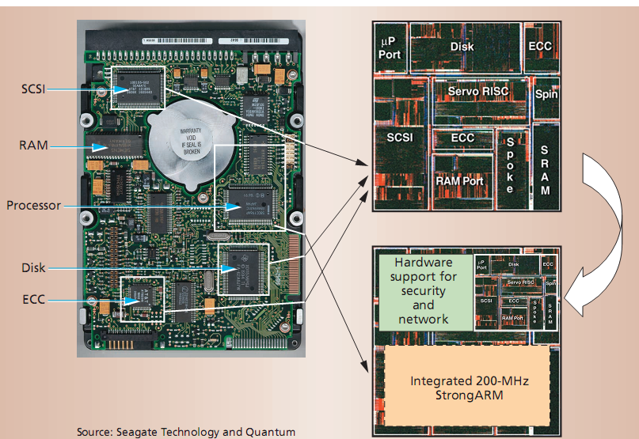
Shrinking Support Hardware…

Slide 29
Example Applications
Media Database
Find similar media data by “fingerprint”
Real Time Applications
Collect multiple sensor data quickly
Data Mining
POS Analysis required adhoc database queries

Slide 30
Approach
Leverage the parallelism available in systems with many disks
Operate with a small amount of state, processing data as it streams off the disk
Execute relatively few instructions per byte of data

Slide 31
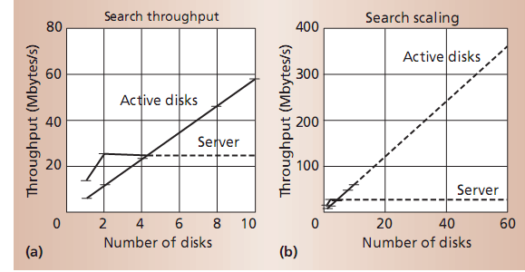
Results- Nearest Neighbor Search
Problem: Determine k items closest to a particular item in a database
Perform comparisons on the drive
Returns the disks closest matches
Server does final merge

Slide 32
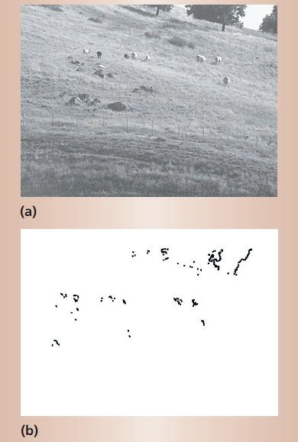
Media Mining Example
Perform low level image tasks on the disk!
Edge Detection performed on disk
Sent to server as edge image
Server does higher level processing

Slide 33
Why not just use a bunch of PC’s?
The performance incease is similar
In fact, the paper essentially used this setup to actually benchmark their results!
Supposedly this could be cheaper
The paper doesn’t really give a good argument for this…
Possibly reduced bandwidth on disk IO channel
But who cares?

Slide 34
Some Questions
What could a disk possibly do better than the host processor?
What added cost is associated with this mediocre processor on the HDD?
Are new dependencies are introduced on hardware and software?
Perhaps other (better) places to do this type of local parallel processing?
Maybe in 2001 this made more sense?

